Slide 1
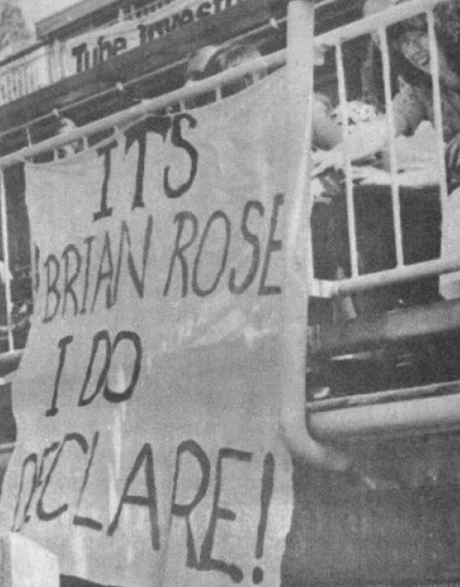
No Trump Declarer Play (By Marc Chawner)

Slide 2
Introduction
The 27 boards that were played in the session were designed to illustrate certain aspects of Bridge Strategy.
This month’s topic was No Trump Declarer Play.
The 27 hands were devised in such a way so that each participant, within the session, found themselves declarer in a tricky No Trump contract on 6 or 7 occasions.
There were a number of ‘Strategies’ that I tried to illustrate within this month’s topic of No Trump Declarer Play.
We will take a look at the boards that were played, strategy by strategy and we will therefore jump around the boards demonstrating the different strategies in action.
Within each board, I have given a suggested bidding sequence, however, for today’s exercise, the bidding is not too much of a concern.
I set the boards up, so that with accurate declarer play, every No Trump Game/Slam should have been made without any guessing involved from the declarer. (However, on two of the boards, this would rely on the defenders fooling for a cleverly designed ‘Trap’ set by the declarer).
So, out of the possible 297 No Trump Game/Slam contracts how many would be made?
The scoring method was Cross-Imps.

Slide 3
5 Step Strategy
We will now take a look at the five steps that a No Trump declarer should take before even thinking about playing that first card from dummy.
Step 1: Focus on just one number and that is the number of tricks that we are trying to make to fulfil our contract, e.g. 3NT = 9 Tricks.
Step 2: Calculate the number of top tricks that we have as a result of the lead. E.g. If the declarer is holding Ace, Queen of the suit that is led, we are allowed to count that as two tricks, otherwise it is just top tricks.
Step 3: Work out a strategy that can make the number from step 2 become the number from step 1.
Step 4: Check that the implementation of our Step 3 strategy will not result in the defenders taking the necessary number of tricks to defeat our contract.
Step 5: Check that we have the necessary communications between the two hands to implement our Step 3 strategy.

Slide 4
Count Our Tricks
I cannot stress enough the importance of getting into the routine of meticulously going through the five steps before we play a card from dummy, when we find ourselves declarer in a No Trump contract.
We start off with a very easy board.
This first board illustrates how we go through our five steps, one at a time, before we play a card from dummy.
The board in question is board 21.

Slide 5
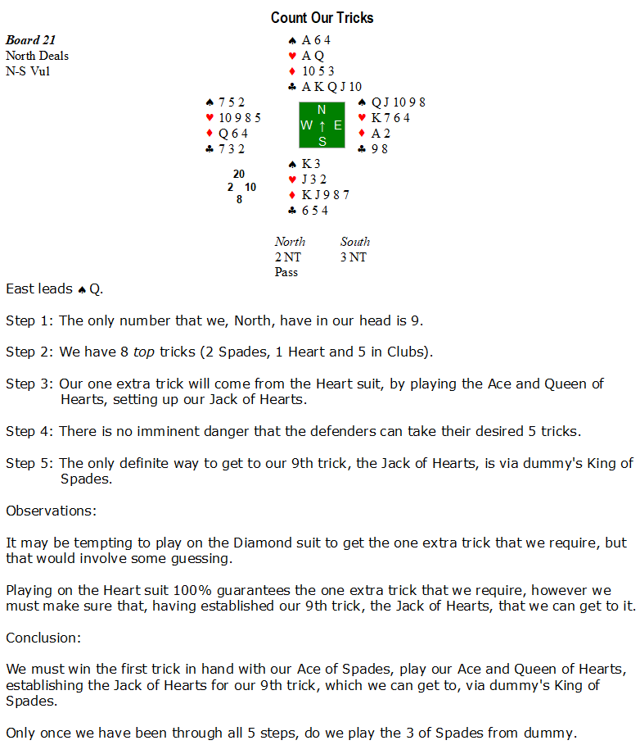

Slide 6
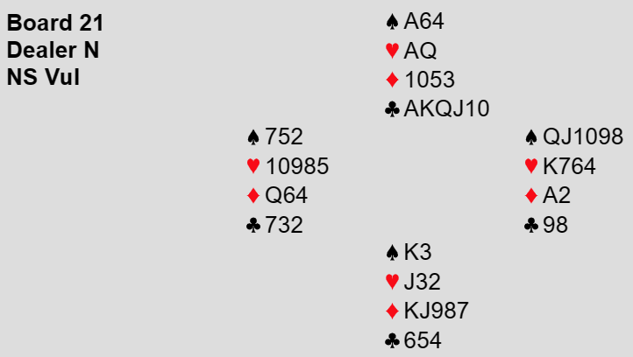
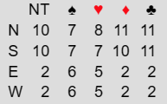
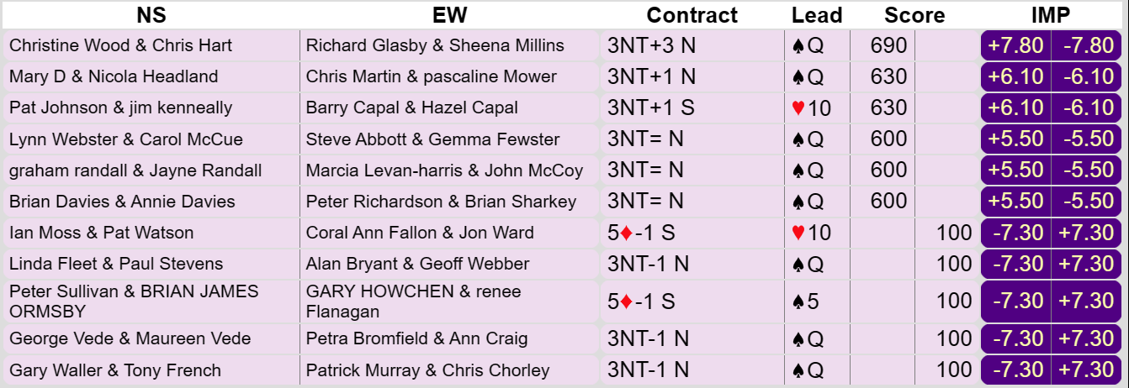
Count our Tricks (Board 21)
Two ‘Gold Medals’ are awarded on this board, namely to Graham Randall and Brian Davies, who were ‘Card Perfect’.
Everyone else either relied on ‘Luck’ or ‘Poor Defending’.
No ‘Medals’ will be awarded to ‘Lucky’ declarers.
The key is to go through the ‘5 Steps’ and realise that just one extra trick is required and that will come from the Heart suit, which involves no guessing.

Slide 7
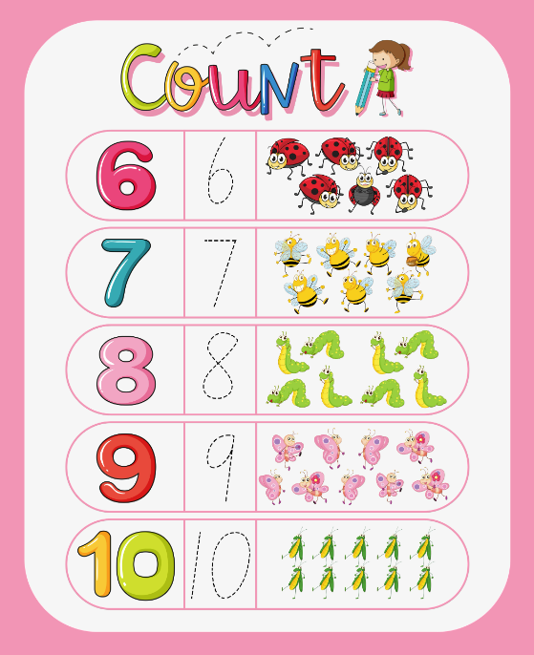
Count Our Tricks (Guiding Principle)
Always count your certain tricks and ask yourself how many you must establish.
Do not make an automatic dash for your longest suit, for there may be a winning line of play against any distribution and any defence.
Make a close study of your entry problems; lack of reflection at trick 1 can often prove costly later.

Slide 8
Hold-Up Play
Let us now look more closely at Step number 4:
Step 4: “Check that the implementation of our step 3 strategy will not result in the defenders taking the necessary number of tricks to defeat our contract”.
Defenders generally have the knack of leading suits where we are most vulnerable.
We are now going to look at some declarer strategies that minimise the possibility that the defenders will win enough tricks to defeat our No Trump contract.
The first one is called the Hold Up play.
Each time that we undertake a No Trump contract we are confronted with the same problem, which is whether we should win the lead immediately or duck and if the latter, how many times should we duck.
It is very important that we duck the correct number of times as it will determine the success or failure of many contracts. By holding up correctly, we will be cutting the communications between our opponents.
We use the ‘Rule of 7’ to determine how many times we should duck.

Slide 9
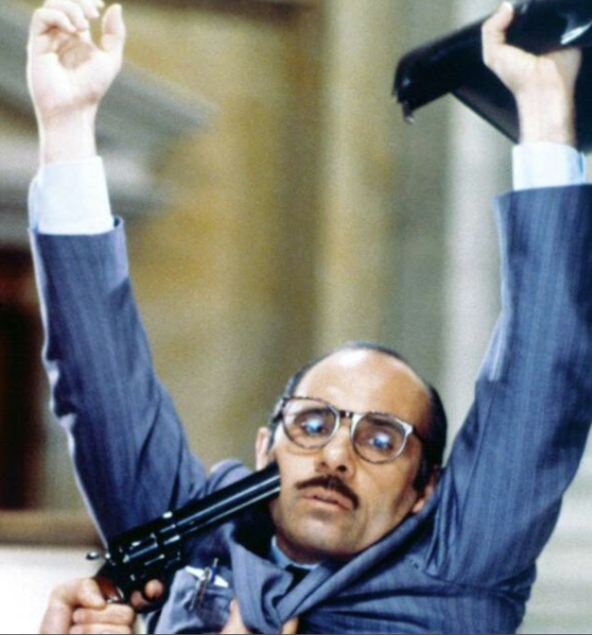
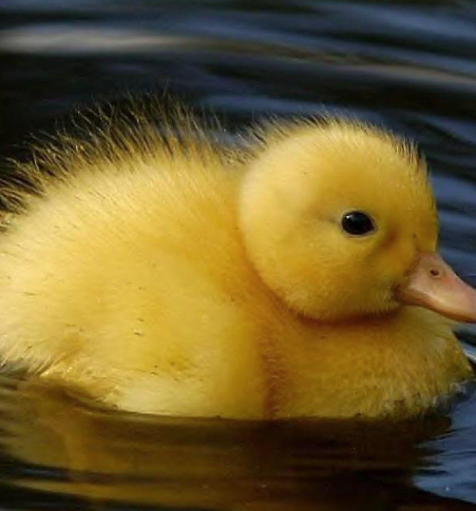
Hold-Up Play (Guiding Principle)
In No Trumps, the technique known as the hold-up is fundamental, for if one of our opponents possesses an established suit, it is essential that their partner should not be able to reach their hand.
For this purpose, the best strategy to employ is the ‘Rule of 7’.
Whenever we possess only one guard in the suit led and envisage giving up the lead only once, count the number of cards we hold in that suit between our two hands, subtract the total from 7, and the answer will be the number of times we are required to duck.
Let us see this in action on board 26.

Slide 10
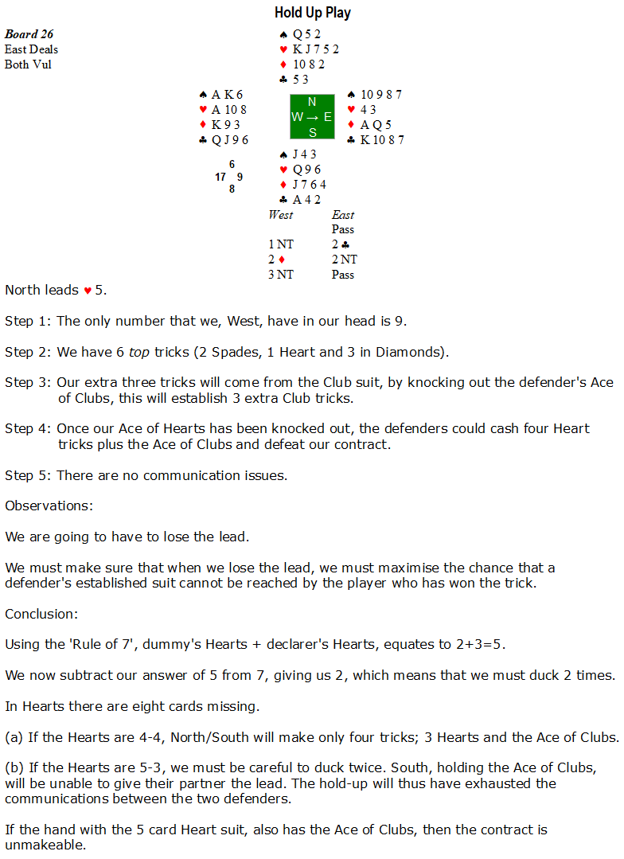

Slide 11
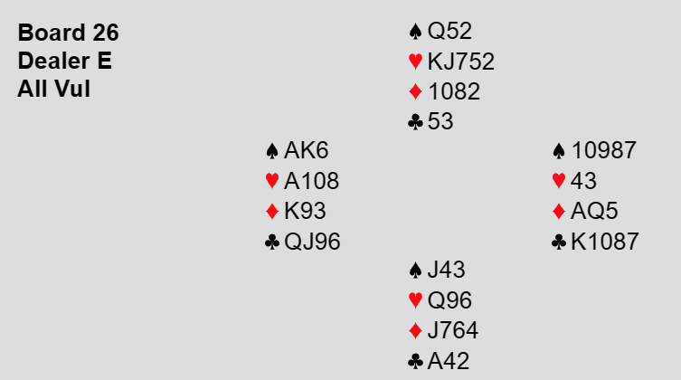
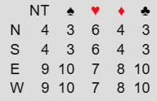
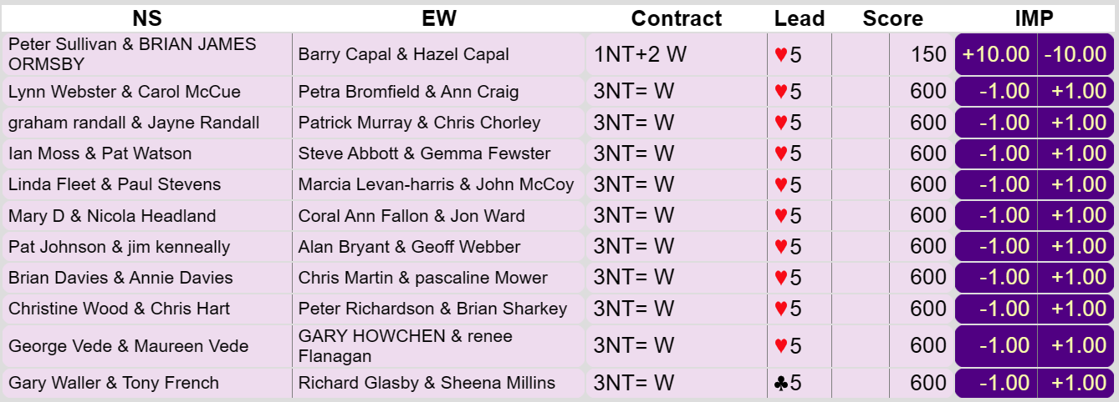
Hold-Up Play (Board 26)
We have found a strategy that we are all familiar with.
Therefore I can award 9 ‘Gold Medals’ to the 9 Wests who were ‘Card Perfect’.
A ‘Silver Medal’ goes to Hazel Capal, who was also ‘Card Perfect, however, she was only in the more conservative contract of 1NT.
Spare a thought for Sheena Millins, who missed out on a ‘Gold Medal’, owing to the fact that her opponents made a ‘Speculative’ double of a Stayman bid and hence received a Club lead.

Slide 12
Hold Up Play With KQxx
The simplest hold up play is when we are holding the Ace, however, when we are holding the King and Queen of the same suit, we treat that holding as if it was an Ace and we employ the ‘Rule of 7’ in the usual way.
Let us see this in action on board 3.
Remember that we subtract how many cards that declarer + dummy hold in the suit and subtract that number from 7 and the answer tells us how many times that we should be holding up.

Slide 13
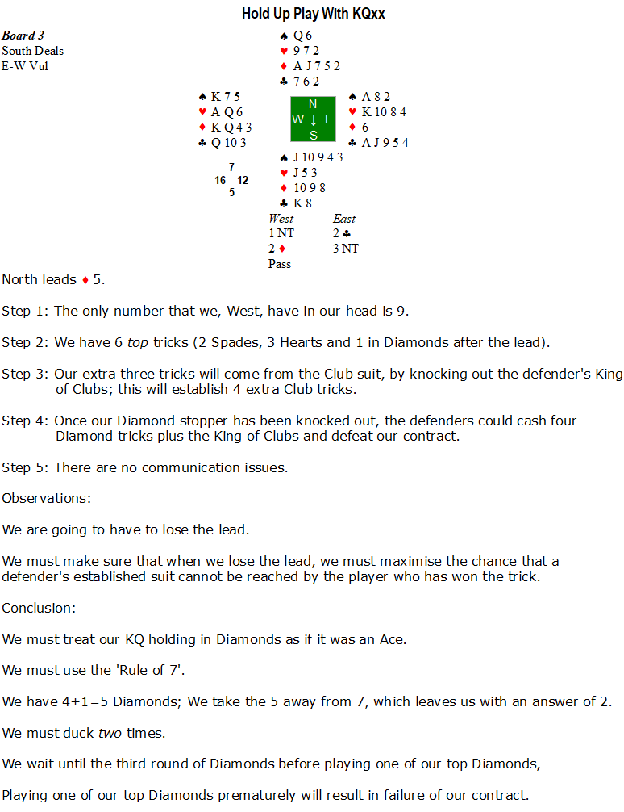

Slide 14
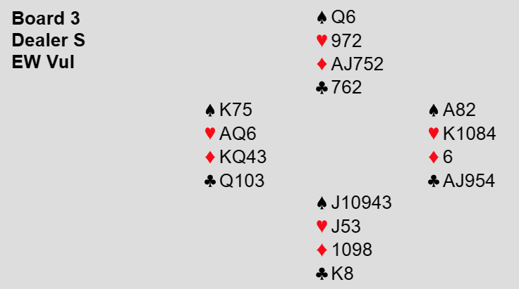
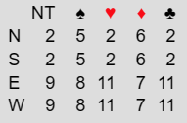
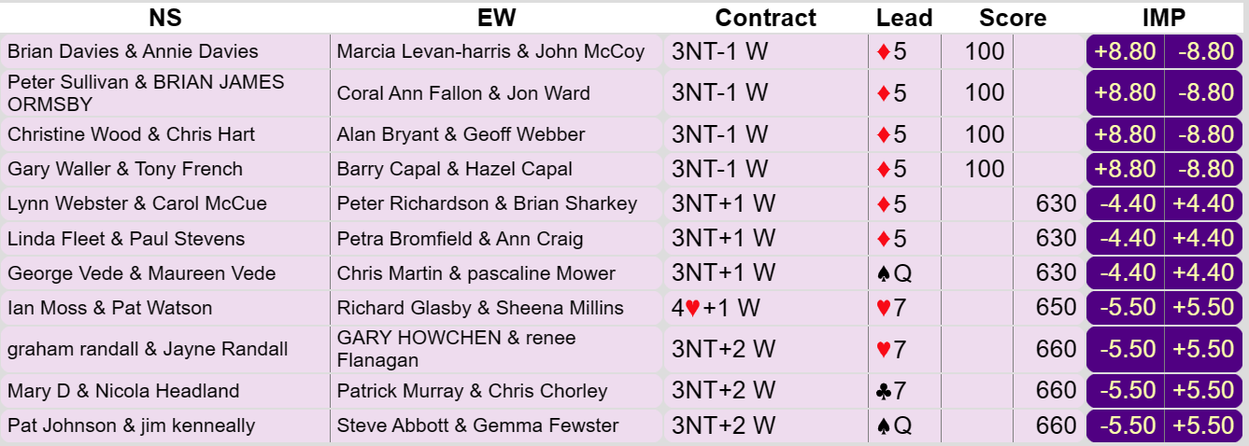
Hold-Up Play with KQxx (Board 3)
No, ‘Gold Medals’ to be awarded on this board, however, only six Wests were put to the test.
It was interesting to observe that the same six Wests, who previously had no problem with holding up their Ace, could not resist playing one of their top Diamond honours on either the first or second round of Diamonds.
The two Wests who played their high Diamond honour on the second round got lucky when their North erred by not ducking that second round of Diamonds.

Slide 15
The Danger Hand
We will now take a look at another of declarer’s strategies which prevents the defenders taking enough tricks to defeat declarer’s No Trump contract. (Step 4).
This is the idea of declarer being able to identify the ‘Danger Hand’.
Quite often, after the opening lead, declarer will be left with a very vulnerable holding in a particular suit, however, if for example declarer’s vulnerable holding consisted of K x in a particular suit and declarer was sitting South, it is only immediately vulnerable if East obtained the lead, because they would be able to lead through the suit, however, whilst West was on lead, declarer would be safe for the time being.
In the image below, East is deemed to be the ‘Danger Hand’ and must be kept off lead at all costs.
Let us take a look at this strategy
in action on boards 14 and 6.

Slide 16
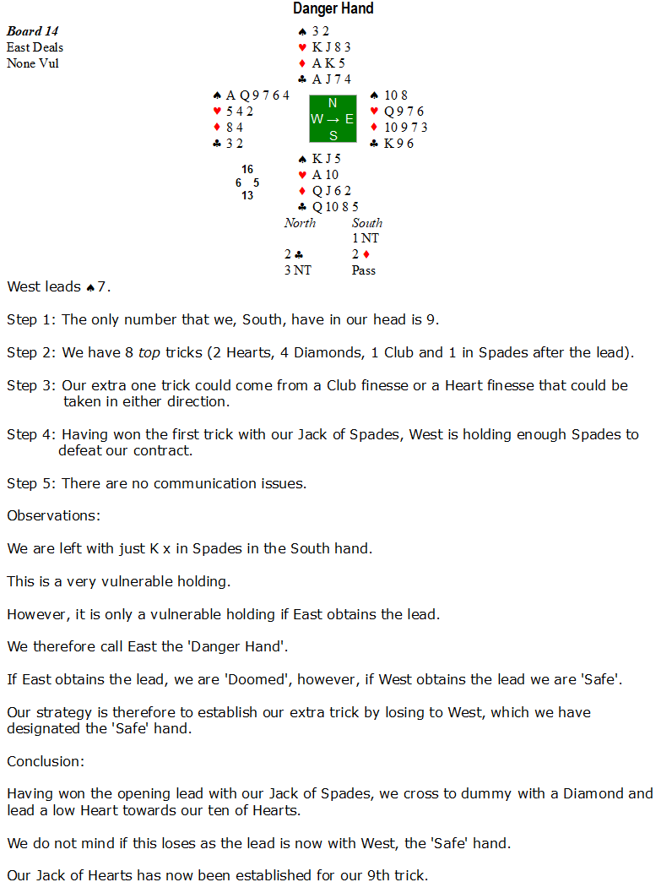

Slide 17
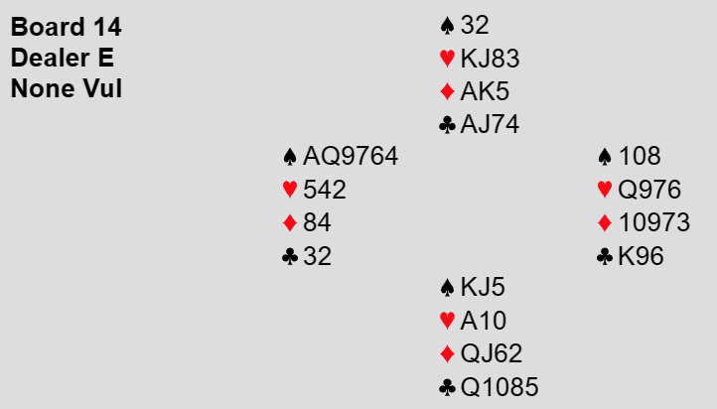
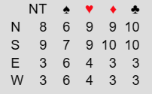
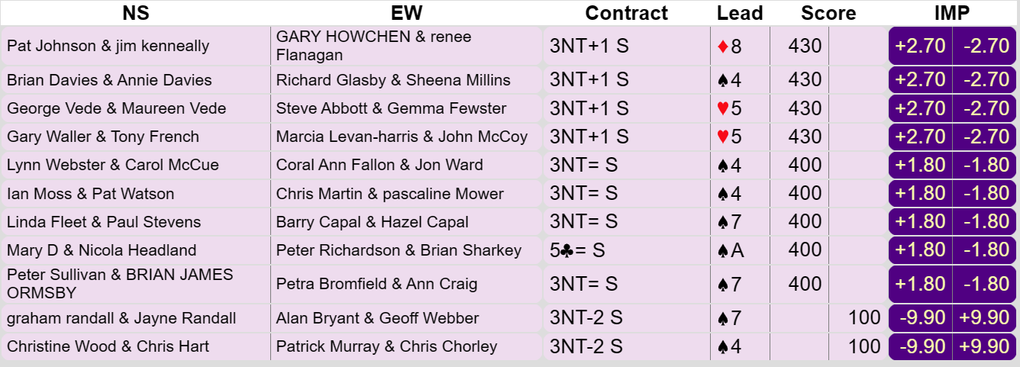
The Danger Hand (Board 14)
Well done to Pat Watson, Paul Stevens and Brian Ormsby, who were all ‘Card Perfect’ and are awarded a ‘Gold Medal’.
I am going to award a ‘Silver Medal’ to Carole McCue, who initially played the Queen of Clubs at trick 2, but then ‘Thought Better of It’ and rose with the Ace of Clubs and led a Heart to her 10.

Slide 19
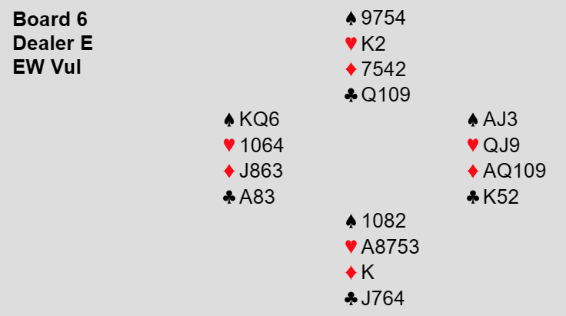
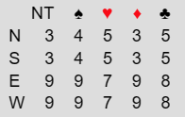
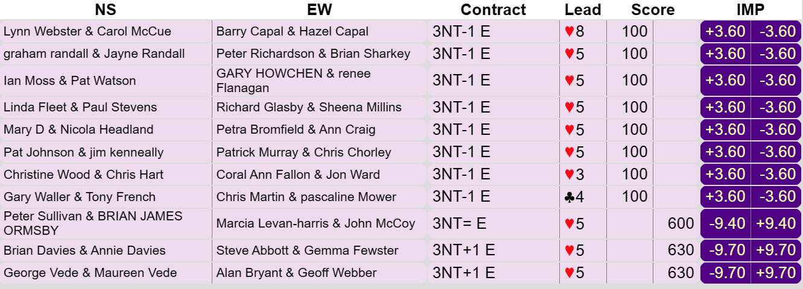
The Danger Hand (Board 6)
Two declarers, namely Steve Abbott and Alan Bryant dropped the singleton King of Diamonds and hence are awarded a ‘Gold Medal’.
To be fair, this is not an easy task to accomplish seeing that every week down at our local duplicate, we are so used to finessing for overtricks.
Well done to Steve and Alan.

Slide 20
The Danger Hand (Guiding Principle)
If one of your opponents is ‘Dangerous’, you must take all necessary precautions to avoid giving them the lead.
One of these is the rejection of a finesse.

Slide 21
Declarer Selects The Danger Hand
The next two boards, namely boards 27 and 25 have a lot of similarities:
1. They both have identical bidding auctions and therefore final contract.
2. They both have identical opening leads of the 4 of Hearts.
3. They both have identical holdings in dummy of the suit led.
4. On both hands the third hand plays the Jack of Hearts.
5. On both hands declarer is holding the identical cards in the suit led.
However, declarer plays a different card at trick one.
How can this be?
By playing a different card at trick one, declarer is selecting where they want the ‘Danger Hand’ to be.
Let’s watch this in action.

Slide 22
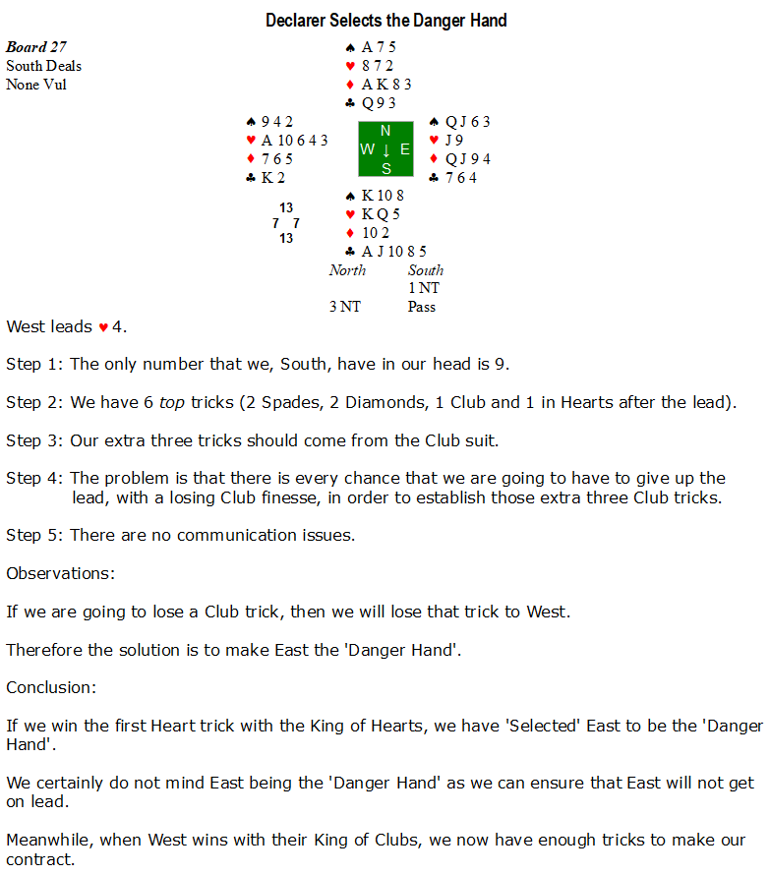

Slide 23
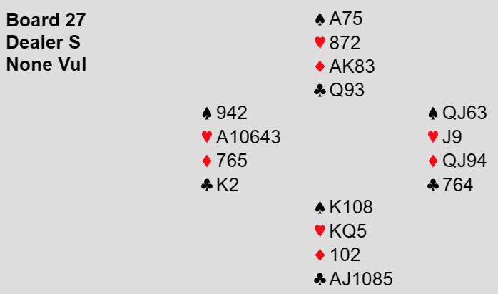
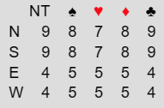
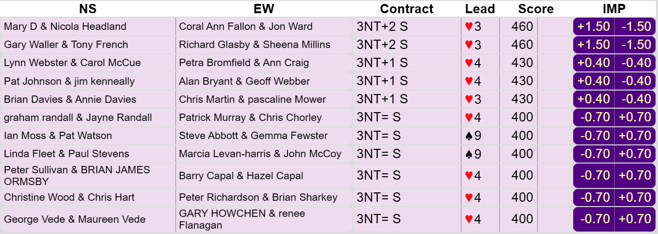
Declarer Selects the Danger Hand (Board 27)
Of the nine Souths, who were put to the test, all nine Souths rose to the occasion and won the first trick.
Well done to all those Souths, who have been awarded a ‘Gold Medal’.

Slide 25
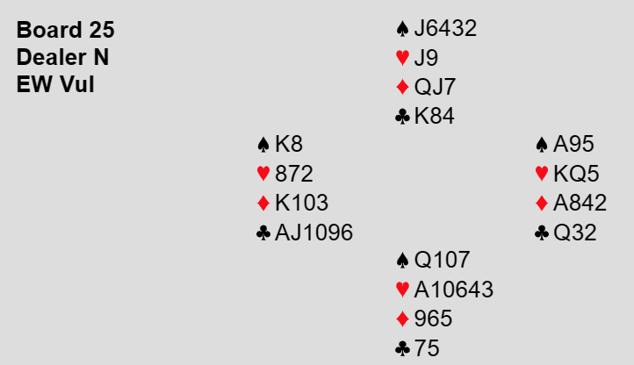
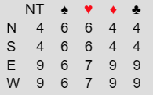
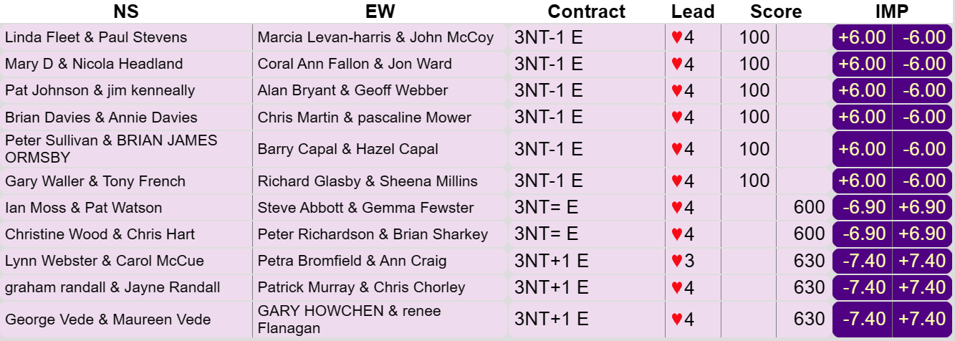
Declarer Selects the Danger Hand (Board 25)
There were three ‘Gold Medal’ winners here, who all managed to resist taking the first Heart trick.
They were: Steve Abbott, Peter Richardson and Patrick Murray.
Well done to those three.

Slide 26
Declarer Selects the Danger Hand (Guiding Principle)
Whether we duck or not with KQx depends on who we fear getting the lead.
If you cannot avoid your right-hand opponent getting in, it is probably right to duck, but if you can keep them off lead, then win the trick immediately.

Slide 27
Which Suit to Tackle First?
Very often, declarer must tackle two different suits to try and establish enough tricks to make their contract.
This could result in declarer having to lose the lead on two separate occasions.
The big question declarer has to answer is which suit should they tackle first?
The answer to that question depends on whether a ‘Danger Hand’ has already been established or whether a ‘Danger Hand’ is imminently going to be established.
In the first case, where a ‘Danger Hand’ has already been established, declarer must first play the suit that ensures that the ‘Danger Hand’ is kept off lead.
However, if there is currently no ‘Danger Hand’, but declarer can foresee a ‘Danger Hand’, ‘On the Horizon’, declarer should first play the suit, which results in declarer subsequently being able to play the suit which keeps the, now established, ‘Danger Hand’ off lead.
Let us see these two scenarios play out.
We will first look at board 24, where the ‘Danger Hand’ is established with the opening lead.
Then we will take a look at board 19, where, although the ‘Danger Hand’ is not immediately established, we can see it ‘On the Horizon’.

Slide 28
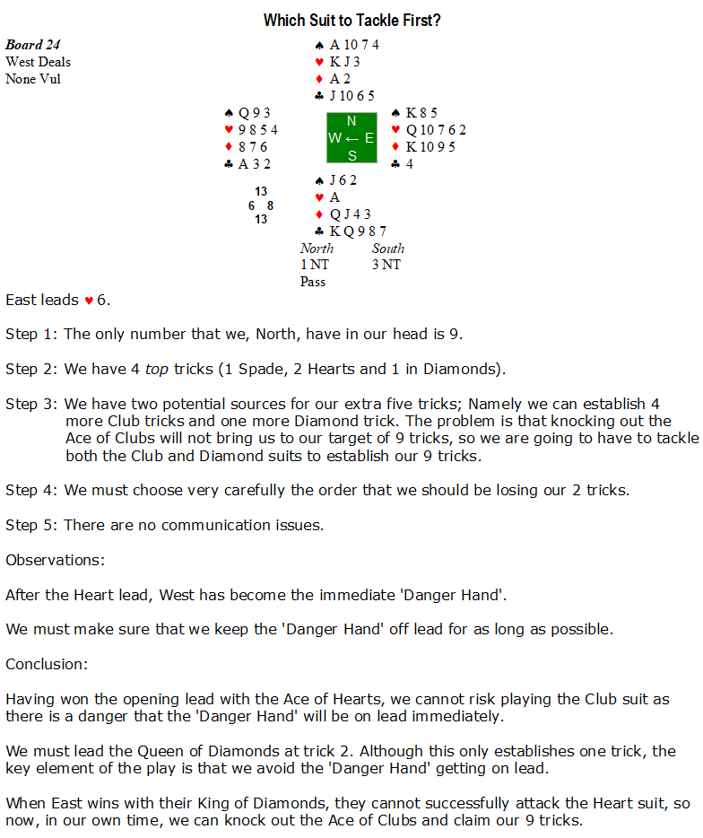

Slide 29
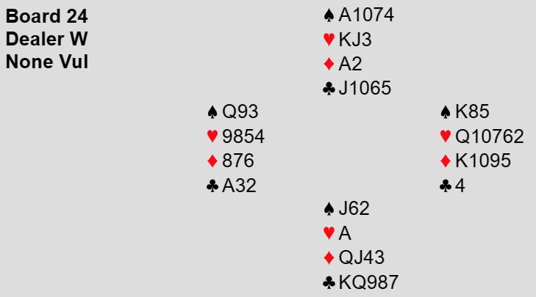
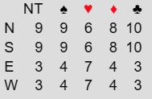
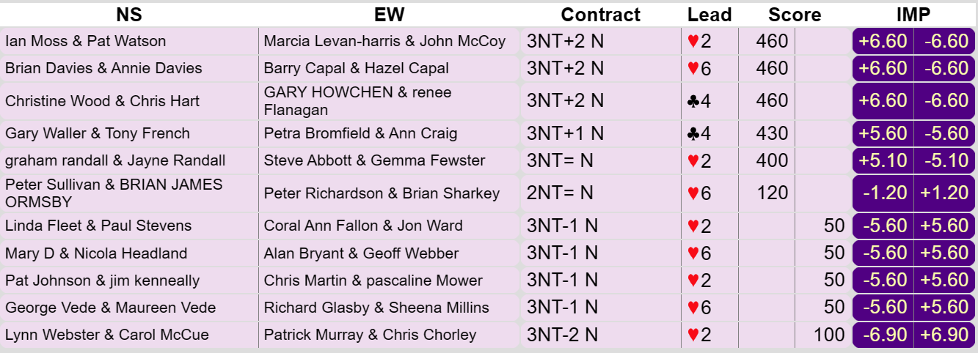
Which Suit to Tackle First? (Board 24)
Three ‘Gold Medallists’ here, with Ian Moss, Brian Davies and Graham Randall being the only three declarers who took the Diamond finesse at trick 2.
I am going to award a ‘Bronze Medal’ to Pascaline Mower, who is the only defender, who appears to have read her notes from the first ‘Boot Camp’, when she rose with her Ace of Clubs at trick 2, when declarer erred when they played a small Club from dummy.
It is essential that West tries to win a trick, before their partner’s entry is knocked out.

Slide 30
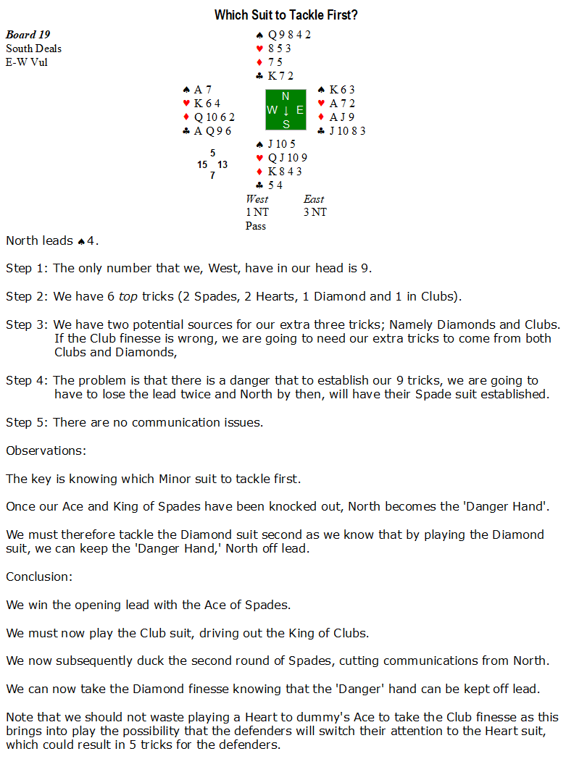

Slide 31
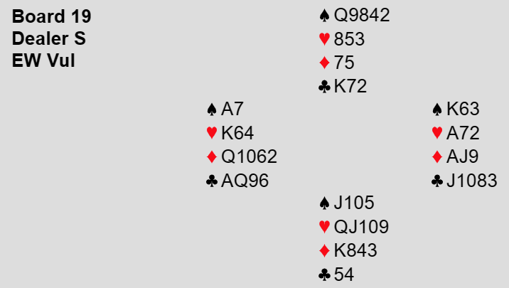
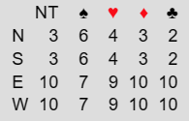
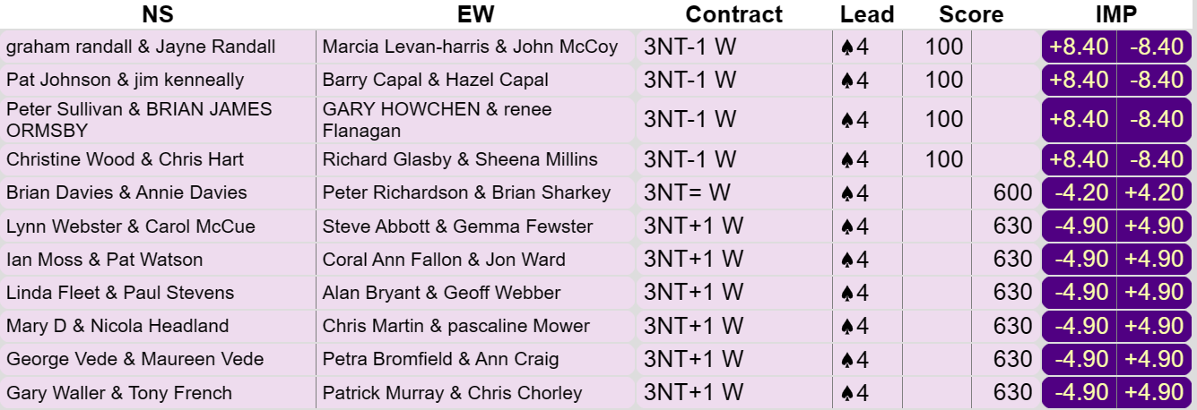
Which Suit to Tackle First? (Board 19)
One outstanding play and most worthy of the only ‘Gold Medal’ from this board and that was from Chris Chorley, who correctly won the lead with the Ace of Spades and laid down the Ace of Clubs and continued with the Queen of Clubs.
This might sound a bit ‘Mean’, but I am only awarding a ‘Silver Medal’ to Gemma Fewster, Jon Ward and Geoff Webber, who correctly played the Club suit before the Diamond suit, however, they crossed over to dummy with a Heart, to take a ‘Superfluous’ Club finesse, which is a losing play, if Hearts had been 5-2.
A ‘Bronze Medal’ goes to Ann Craig, who also played the Clubs first, however, crossed to dummy to take the Club finesse, via a Diamond to the Ace, but got away with it.

Slide 32
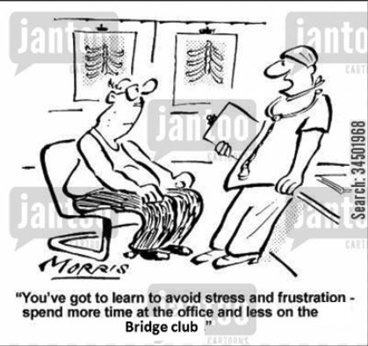
The Avoidance Play
Continuing with our ‘Danger Hand’ theme, let us look at another strategy that declarer can use, to prevent the ‘Danger Hand’ getting the lead.
This strategy is known as the ‘Avoidance Play’.
Let us look at it in action on board 10.

Slide 33
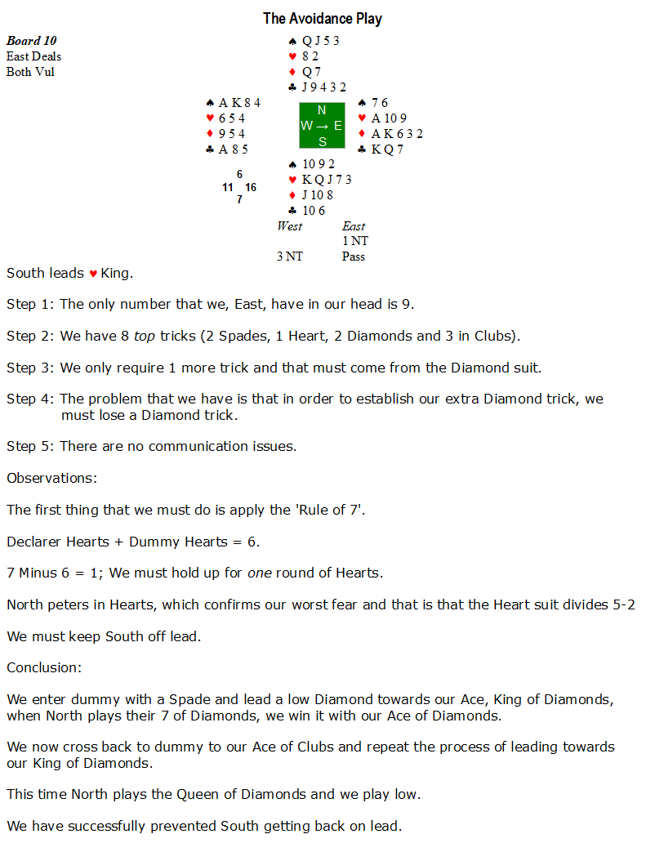

Slide 34
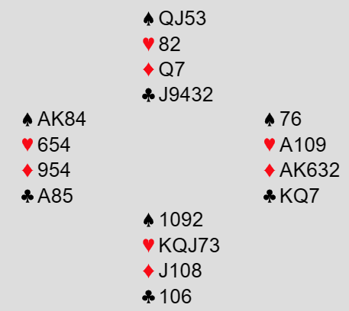
The Avoidance Play
It is interesting to note what happens if declarer ignores the ‘Rule of 7’ and decides to hold up for a second time and therefore winning the third round of Hearts.
On the third round of Hearts, North has the opportunity to ‘Make Napoleon Proud’, by discarding the Queen of Diamonds and hence executing an ‘Emperor’s Coup’.
See board 8 and page 81 of the defence ‘Boot Camp’.

Slide 35
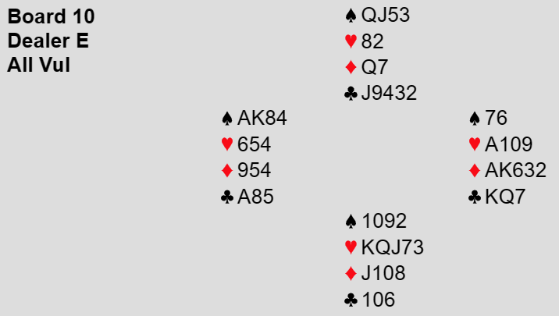
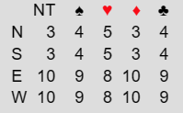
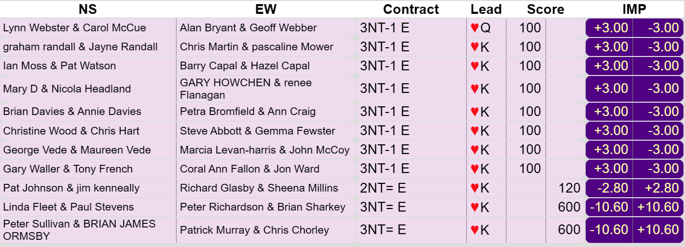
The Avoidance Play (Board 10)
Zero ‘Gold Medals’ to be given out on this board.
Virtually every declarer held up the Hearts to the third round, which gave an opportunity ‘To Make Napoleon Proud’, but no North took that opportunity.
It really did not matter as all the declarers just played their two Diamonds from the top.
I will award a ‘Bronze Medal’ to Brian Davies, who, although he ‘Did not make Napoleon Proud’, he at least played his Queen of Diamonds under declarer’s Ace of Diamonds, ensuring an entry to partner’s established Heart suit.

Slide 36
The Block Defence
A rule is not perfect unless it has its exceptions.
The rule I am referring to is the ‘Rule of 7’, where we calculate how many times a declarer should duck the lead.
Typically when dummy is holding Ace doubleton in the suit led and declarer is holding a 4 card suit, there are certain holdings where we do not apply the ‘Rule of 7’.
Normally when dummy is holding a doubleton and declarer is holding a 4 card suit, the ‘Rule of 7’ equation is 7 Minus 6 = 1. i.e. Declarer should duck once.
As we will see from board 15, with certain holdings, we must ignore the ‘Rule of 7’.

Slide 37
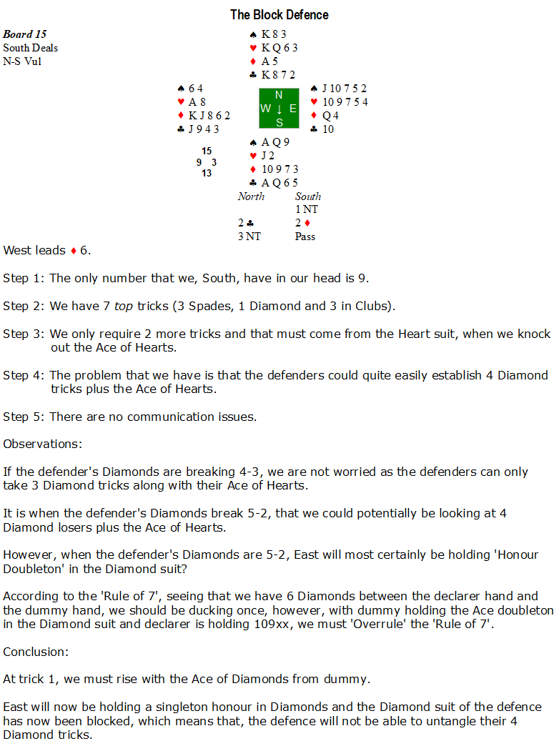

Slide 38
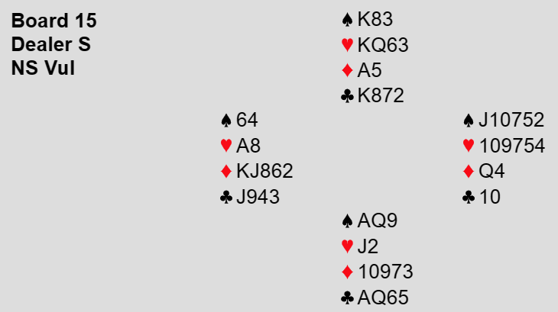
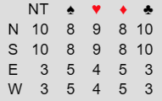
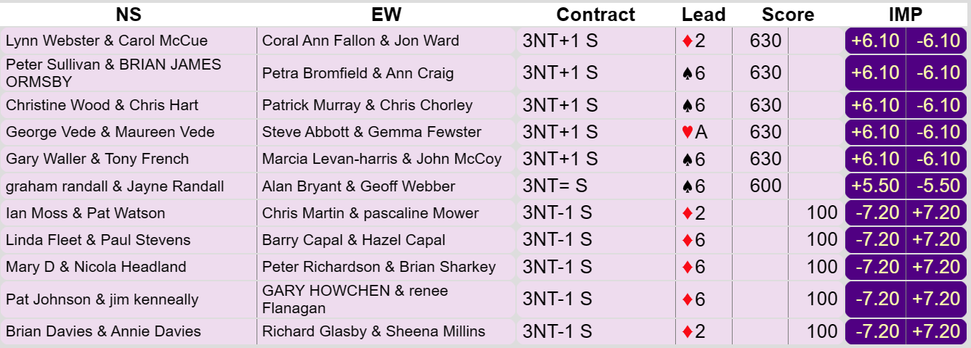
The Block Defence (Board 15)
No ‘Blocking’ going on here, with no declarer rising with dummy’s Ace of Diamonds and therefore no ‘Gold Medals’ awarded.

Slide 39
The Block Defence (Guiding Principle)
Here are another two holdings, where rising with the Ace in dummy will ‘Block’ the defender’s tricks.

Slide 40
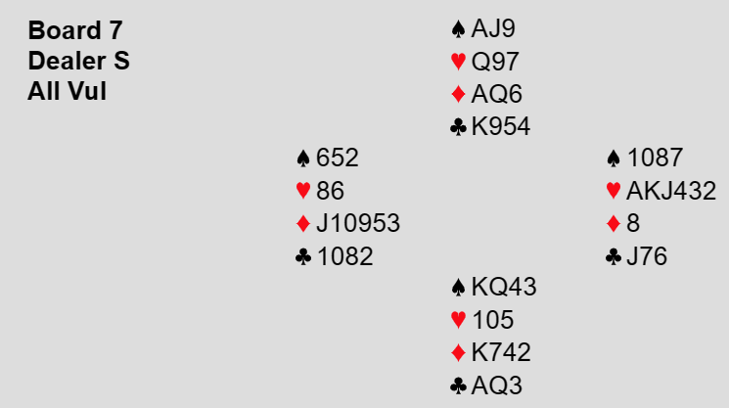
Quick Observation
One thing I have noticed from this event is that many people seem to be leading, on quite a few occasions, from their doubletons against the No Trump contracts?
It is as if my previous ‘Boot Camp’ has ‘Traumatised/Hypnotised’ people into leading their short suits against No Trump contracts.
If we take a look back at board 7 from the Defence Boot Camp, where I suggested leading the doubleton Heart, the reason was because our partner has all the points and we have nothing.
The idea regarding leading against No Trumps is that we want to lead the longest suit of the person who has the majority of points, because once we have set the suit up, they will still hopefully have an entry left in their hand.
On the board that we just played, board 15, our hand has the majority of points, so we should be leading our longest suit, Diamonds. The people leading their doubleton 6 of Spades, may well find their partner with a 5 card Spade suit, but our partner’s hand is known to scarcely have any points.

Slide 41
Play High From Dummy to Block Defence
From ‘Child Birth’, we have always been told that ‘Second Hand Plays Low’, however when we know certain things about the hands at the table, we are allowed ‘To Break The Rules’.
Let us look at declarer ‘Breaking the Rules’ on Board 5.

Slide 43
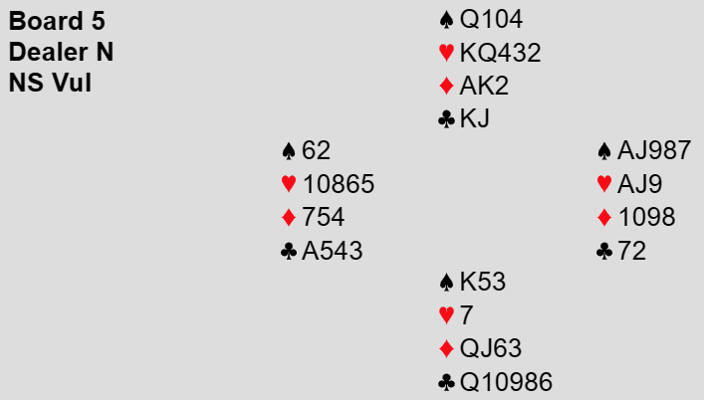
Play High From Dummy to Block Defence (Board 5)
The auction did not always go as I had hoped, however, when it did, just the one declarer, namely Paul Stevens, rose with dummy’s Queen of Spades at trick 1 and therefore Paul was the one and only recipient of a ‘Gold Medal’ from this board.

Slide 44
Preserving Entries
It is all well and good establishing a suit which can provide us with tricks, but we need to be able to get to the established suit.
i.e. We need an entry to cash out our established tricks.
Sometimes we have to do all we can, to preserve those precious entries to our soon to be established suit.
Board 20 shows this idea in action.

Slide 46
Preserving Entries (Board 20)
Although the contract of 3 No Trumps was made on a number of occasions, most of the time it was down to poor ‘Essex Defending’, however three declarers did make the contract the correct way, which was to rise with the King of Hearts in dummy at trick 1.
Well done to Steve Abbot, Petra Bromfield and Patrick Murray who all earned themselves a ‘Gold Medal’.

Slide 47
Generating Entries
Sometimes we have no entries to preserve, so we must generate entries.
The next three boards namely boards 8, 12 and 4 show three different techniques on how to generate extra entries.

Slide 49
Generating Entries (Board 8)
Just the two declarers spotted the correct line here of overtaking their Queen of Diamonds with dummy’s Ace to generate that all important extra entry.
Carol McCue and Paul Stevens can wear their ‘Gold Medals’ with pride.

Slide 51
Generating Entries (Board 12)
Unfortunately, too many defenders were ducking the first round of Hearts, so most declarers were never under any pressure to play the Diamond suit in the correct sequence.
Only two declarers made the ‘Fancy’ play in the Diamond suit, one was Ian Moss, who had incorrectly ducked the initial Club lead (Rule of 7=No Duck), so only a ‘Silver Medal’ for Ian.
The other one was Peter Sullivan, who also played the nine of Diamonds to the Ace, but, unfortunately slipped up, right at the end, so a ‘Bronze Medal’ to Peter, for a ‘Good Effort’.

Slide 53
Generating Entries (Board 4)
Two ‘Gold Medallists’ on this board, with the remaining contenders all falling at the first hurdle by winning the opening trick with their 10 of Spades.
The two ‘Gold Medal’ winners were Brian Sharkey and Chris Chorley.
Well done to Brian and Chris.

Slide 54
Communication Problems
Step 5 can sometimes be a real ‘Nightmare’ to resolve.
Step 5 being, “Check that we have the necessary communications between the two hands to implement our Step 3 strategy”.
‘Trial & Error’ can sometimes be the best way forward.

Slide 56
Communication Problems (Board 11)
The key to this board is realising at trick 1, that the first trick must be won with the Ace of Spades as the King of Spades is required at the end of the hand as an entry to the 13th Heart.
On that basis, the only ‘Gold Medal’ that I can hand out on this board is to Ian Moss, who was the only declarer to have won the opening lead correctly with the Ace of Spades.
Well done Ian.

Slide 57
Finessing
Probably one of the first ‘Strategies’ that we were taught at bridge is the strategy of, ‘How to Finesse’.
The big question is: Were we taught how to finesse in more complex situations?
Let us find out by looking at boards 23 and 17, where our finessing skills are put to the test.

Slide 59
Finessing (Board 23)
Technically no ‘Gold Medals’ are to be handed out on this board as most of the declarers led the Jack of Hearts at some stage which meant that four Heart tricks could never be achieved.
I am going to give Coral Fallon the ‘Benefit of the Doubt’ and award Coral a ‘Silver Medal’.
Coral correctly initially led a small Heart from dummy and received a ‘Helping Hand’ when the King appeared, so she had no trouble collecting her nine tricks.
The big question is whether she would have led a small Heart from dummy, the second time?
Only Coral knows that.

Slide 60
Finessing (Guiding Principle)
If you have sufficient entries, do not play an honour when finessing on either of the first two rounds of the suit with holdings such as:

Slide 62
Finessing (Board 17)
Five declarers correctly led the 9 of Hearts for the first Heart finesse.
So five ‘Gold Medals’ go to, Graham Randall, Ian Moss, Linda Fleet, Pat Johnson and Christine Wood.

Slide 63
Suit Combinations
This is probably the most ‘Boring’ bit about bridge.
‘Going Back to School’ and learning how to play certain ‘Suit Combinations’.
For example:
How would you play this suit combination?
You have plenty of entries and you require three tricks?
I can tell you that there is a 77.6149% chance that you will make at least 3 tricks.
Would you play any differently, if you are required to make all four tricks?
Whilst you think about that, let us look at board 9, where knowing how to play our ‘Suit Combinations’ comes in very handy.

Slide 65
Suit Combinations (Board 9)
Only one ‘Gold Medal’ to be given out here and that is to Ian Moss, who was the only declarer to play a Heart towards the nine.
Congratulations to Jayne Randall, who decided to keep her Heart suit a ‘Secret’ and therefore entice a ‘Gift’ of an opening Heart lead.

Slide 66
Suit Combinations
Answer to our ‘Suit Combination’ problem.
Initially we should play low towards the 10 and assuming that loses, we next cash one top honour and then play low towards the 9.
We play no differently, if we are trying to make all 4 tricks.
As a ‘Special Treat’, seeing that you all did so well on Sunday, I will be sending out to everyone who participated in Sunday’s event, some special software, later in the week, that runs on your computer and is absolutely free.
The idea is that you can type in any suit combination you want, along with how many tricks you are trying to make and the software will tell you the correct mathematical way to play that ‘Suit Combination’.

Slide 67
Murphy’s Law (Safety Play)
All good declarers are pessimistic.
All good declarers always assume the worst.
All good declarers prepare for the worst possible layout to exist.
If we can afford to lose a trick, then take time considering how we can cater for the worst layout to exist.
This is known as the ‘Safety-Play’.
Let us see this in action on board 13.

Slide 69
Murphy’s Law (Safety Play) (Board 13)
Not one single declarer played the Diamond suit correctly.
A couple of declarers manage to convince the defenders to mis-defend, but no medals are given out to ‘Lucky’ declarers.

Slide 70
Deceptive Declarer Plays
When things are looking ‘All Lost’ for a declarer, consider making a play that will deceive the defenders.
Let us see a couple of deceptive plays from declarer on boards 7 and 1.

Slide 72
Deceptive Declarer Plays (Board 7)
No ‘Gold Medals’ to be handed out here, as every declarer won the opening Spade lead with their Queen.
Only one defence took advantage of this ‘Error’ by the declarer and that was the partnership of Ian Moss and Pat Watson, who both receive a ‘Bronze Medal’ for their defensive efforts on this board.

Slide 74
Deceptive Declarer Plays (Board 1)
I am very tempted to hand out some ‘Detentions’ here as it is very obvious that many of you did not do your ‘Homework’.
Why are so many defenders, having led the King of Hearts at trick 1, continuing with the Heart suit, when we ‘Learnt’ in the previous ‘Boot Camp’, that our partner would play the Jack, if they held it?
‘Bronze Medal’ to Patrick Murray, who was the only defender to correctly switch to the Spade suit.
No ‘Gold Medals’ to the declarers, as no declarer found the ‘Imaginative’ play of the Jack at trick 1.

Slide 75
Counting the Hand
Sometimes at the bridge table, declarer has to play the role of ‘Inspector Clouseau’.
Whenever declarer has a big decision to make, it is very important that all the evidence must be collected before this big decision is made.
Let us look at ‘Inspector Clouseau’ in action on board 22.

Slide 77
Counting the Hand (Board 22)
9 Declarers decided to take a ‘Guess’ at the Club suit at trick 3 and most guessed wrongly.
Only one declarer, namely, Steve Abbot could be bothered to cash out all the other 3 suits and make his contract with ease and earn himself a ‘Gold Medal’.
Gary Howchen cashed out 9 tricks, but then got ‘Bored’ and made his decision at trick 10, but at least he made some effort, so a ‘Bronze Medal’ for Gary.

Slide 78
Count Our Tricks (Do Not Get Greedy)
This next hand demonstrates how declarer must be constantly on the lookout for the ‘Dangers’ that exist on a hand.
Step 1, (Placing our target number of tricks into our head), although it is the simplest task to perform, it is also the most important task.
The key concept to remember is to never put our contract in jeopardy for the sake of trying to get some overtricks.
It is sometimes very tempting to ‘Grab an Extra Trick’.
This is all well and good, if we have already secured our contract, however, until we have made sufficient tricks to secure our contract, the word ‘Overtrick’ does not exist in the vocabulary of a declarer.
Let us see some of these aspects in action on the next hand, which is board 18.

Slide 80
Count Our Tricks (Do Not Get Greedy) (Board 18)
Every declarer was ‘Greedy’ on this board and not one single declarer played the Ace of Hearts at trick 1.
No one deserves a ‘Gold Medal’ for being so greedy.

Slide 81
Suit Combinations + Danger Hand
This next hand is certainly tough.
Declarer has to firstly use their ‘Suit Combinations’ knowledge and then identify the danger hand to make their contract without any guessing.
The suit combination is:
We are required to make 4 Club tricks and we can afford to lose one, however it is not as straight forward as it looks as there are other factors involved outside of the Club suit.
Let us see this tough hand in action on board 16.

Slide 83
Suit Combinations + Danger Hand (Board 16)
To be honest, this was a difficult hand to play, without any guessing involved.
However, one declarer earnt themselves a ‘Gold Medal’ and that was Brian Sharkey.
Well done Brian.

Slide 84
Think Outside The Box
The last ‘Boot Camp’ hand is always a ‘Classic’ and this ‘Boot Camp’ is no exception.
Let us now list out declarer’s ‘Box of Tricks’ that they can now use on the unsuspecting defenders, when playing in a No Trump contract.
1. Hold Up Play
2. Identifying the ‘Danger Hand’.
3. Avoidance Play.
4. Preserving Entries.
5. Creating Entries.
6. Block Defence.
7. Deceptive Plays.
8. Play High from Dummy.
Sometimes none of the above strategies will work on a certain hand.
When this happens, declarer has to ‘Think Outside The Box’ and come up with some imaginative card play.
Let us watch this in action on board 2.

Slide 86
Think Outside The Box (Board 2)
All I need to say is that all the declarers are safely ‘Inside Their Box’, so there are no medals on this board.

Slide 87
Final Medal Table

Slide 88
Extra ‘No Trump Declarer Play’ Homework for Everyone
Before you go to bed at night, as well as reciting the ‘Lord’s Prayer’, recite ‘The 5 Steps’ that a No Trump declarer should be going through, when they first see dummy.

