Slide 1
ORGANIZING
A Youth program
SET UP FOR
SUCCESS
Patty Tucker
October 2023
Notes:
Presentation slide for courses, classes, lectures et al.

Slide 2
NEVER FORGET
Playing bridge is supposed to be fun.
Teaching bridge is ALSO supposed to be fun!
Notes:
Beginning course details and/or books/materials needed for a class/project.

Slide 3
Before You Start
What do you want to accomplish?
Ensure that everyone involved has the same goal.
Our GOAL was to introduce thousands of children to the game and give them a basic foundation that would allow them to play for the rest of their lives.
Our HOPE was that some of them would become as enthralled, interested and love the game as much as we love bridge.
© 2021 Patty Tucker

Slide 4
Before You Start
Assure that your goal is realistic. Understand that it will not happen in a week, a month or (maybe) a year.
These programs take time to create and time to develop to their full potential.
Know that you will have a series of ‘trial and error’ and some growing pains.
© 2021 Patty Tucker

Slide 5
Organizational Considerations
Organizing a program:
Location
Volunteers
Supplies
Administration & Finances
Marketing
Teachers
© 2021 Patty Tucker

Slide 6
Organizational Considerations
Locations for Teaching
Schools
Churches
Recreation centers
Libraries,
Bridge Clubs
Clubhouses of homeowner association
Neighborhood Classes in a home (be careful of trying this due to potential liability issues).
© 2021 Patty Tucker

Slide 7
SCHOOLS VS. CLUBS
PLUSES & MINUSES OF PROGRAMS IN SCHOOLS VS. CLUBS
SCHOOLS
Kids are already at the school – no travel required. Parents feel that the school is a safe environment. Messages sent home from a teacher or school are always read. Teachers can arrange ‘field trips’ Hard to make the transition from a ‘school’ activity to a ‘community’ activity. Bridge teacher/player often do not meet the parents directly.
CLUBS
Parents must bring the kids to the class. Parents are not familiar with the people, teacher or other parents. Messages concerning games, camps, playing opportunities may not get read. Once the parents have met you and see their child likes bridge, they buy into the games and camps. Parents can become an ‘in’ to schools. Parents can become fundraisers. Parents can become volunteers. Parents may learn bridge.

Slide 8
Organizational Considerations
Other Location considerations:
Where are you going to
Store supplies?
Hold meetings
Store documents
Conduct the financial and administrative duties?
© 2021 Patty Tucker

Slide 9
Organizational Considerations
What is your Volunteer base? You will need volunteers to:
Find, store and move supplies for classes and games
Organize fund raisers and/or raise money
Marketing your classes
Build student lists, organize field trips
Help the teachers in the classrooms
A million other things you haven’t thought of!
© 2021 Patty Tucker

Slide 10
Organizational Considerations
What is your Volunteer base? You will need volunteers to:
Find, store and move supplies for classes and games
Organize fund raisers and/or raise money
Marketing your classes
Build student lists, organize field trips
Help the teachers in the classrooms
A million other things you haven’t thought of!
© 2021 Patty Tucker

Slide 11
Organizational Considerations
Supplies:
Teaching supplies – books, cards, boards, bidding boxes, table mats, card holders
Snacks
Sign-up sheets with contact information, parental information
© 2021 Patty Tucker

Slide 12
Organizational Considerations
Administration:
Are you a non-profit? What legal steps need to be followed.
Who is responsible for reporting your income and expenses.
Who pays your teachers? Orders supplies? Who is in charge of any contractual obligations?
© 2021 Patty Tucker

Slide 13
Organizational Considerations
Finances
Are you going to pay your teachers?
Are you going to pay an organizer?
Who pays for travel expenses?
Who pays for snacks?
Do you need to buy supplies?
Are you going to charge your students? If so, what will those fees cover?
© 2021 Patty Tucker

Slide 14
Organizational Considerations
Marketing
Do you have a name, a logo, a website, a phone number, an email address?
How will you advertise your classes and/or availability?
Who will take pictures? Create flyers? Make posters?
Who will create and maintain your website.
Who will maintain your data base. How will you contact players.
© 2021 Patty Tucker

Slide 15
Organizational Considerations
Teachers
What experience or credentials do you require?
Who overseas their performance?
Do you require your teachers to be vetted by a government agency?
Are you going to team teach vs. one teacher per class?
Do you have volunteers to help your teachers?
Are your teachers being paid? Do you have a contract?
© 2021 Patty Tucker

Slide 16
RESOURCES
Don’t reinvent the wheel! There are several resources available to help you with your youth program. Here are a few of which I’m familiar with:
Jump Start Bridge www.jumpstartbridge.org
ACBL www.acbl.org
Bridge Teachers for Youth www.btfy.org

Slide 17
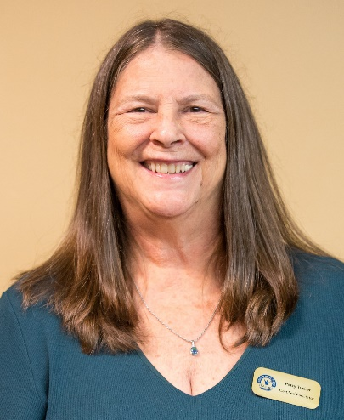
About Patty Tucker
President and Founder of Atlanta Junior Bridge
ACBL Hall of Fame, Blackwood Award
ACBL Best Practices Certified Teacher/Trainer
ACBL Online Teacher Certification
American Bridge Teachers’ Association (ABTA) Master Teacher and Past President
ACBL Grand Life Master
ACBL Honorary Member 2016
ACBL Goodwill Member of the Year 2011

