Slide 1
Flipping the Script
Rethinking How We Teach Bridge to Youth
Michael Rushworth
BAMSA Community Researcher

Slide 2
My Bridge/Teaching Journey
Started when 18, played at university
Maths/Business/Economics teacher
Taught online during Covid
Teaching in schools/online to youth
BAMSA Case Studies on Schools bridge

Slide 3
Flipping the Script
Cognitive Science (the art of teaching and learning)
Gamifying Learning
Technology and Teaching
What makes the ideal bridge lesson?

Slide 4
Cognitive Science
Willingham, Why Don’t Students Like School?

Slide 5
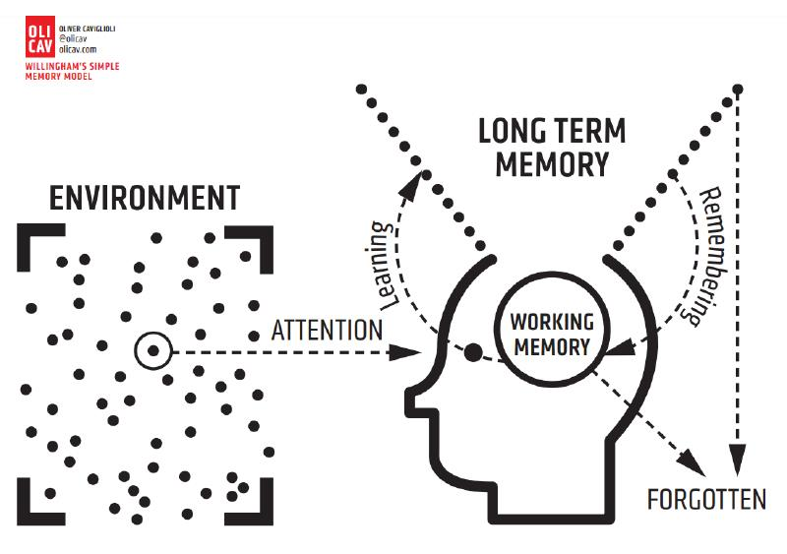
Cognitive Science
Willingham, Why Don’t Students Like School?

Slide 6
Cognitive Science – good examples

Slide 7
Behaviour Management
Make sure everyone is listening
Be positive
Correct, but give leeway during boards
Be nice – unconditional emotional positivity
Tell them what you want them to do

Slide 8
Flipping the Script
Cognitive Science (the art of teaching and learning)
Gamifying Learning
Technology and Teaching
What makes the ideal bridge lesson?

Slide 9
Gamifying Learning – Marvel Snap
“Depth vs Complexity”
“More is More?”
“Depth Limit” – you only have one lifetime!
https://www.youtube.com/watch?v=HjhsY2Zuo-c

Slide 10
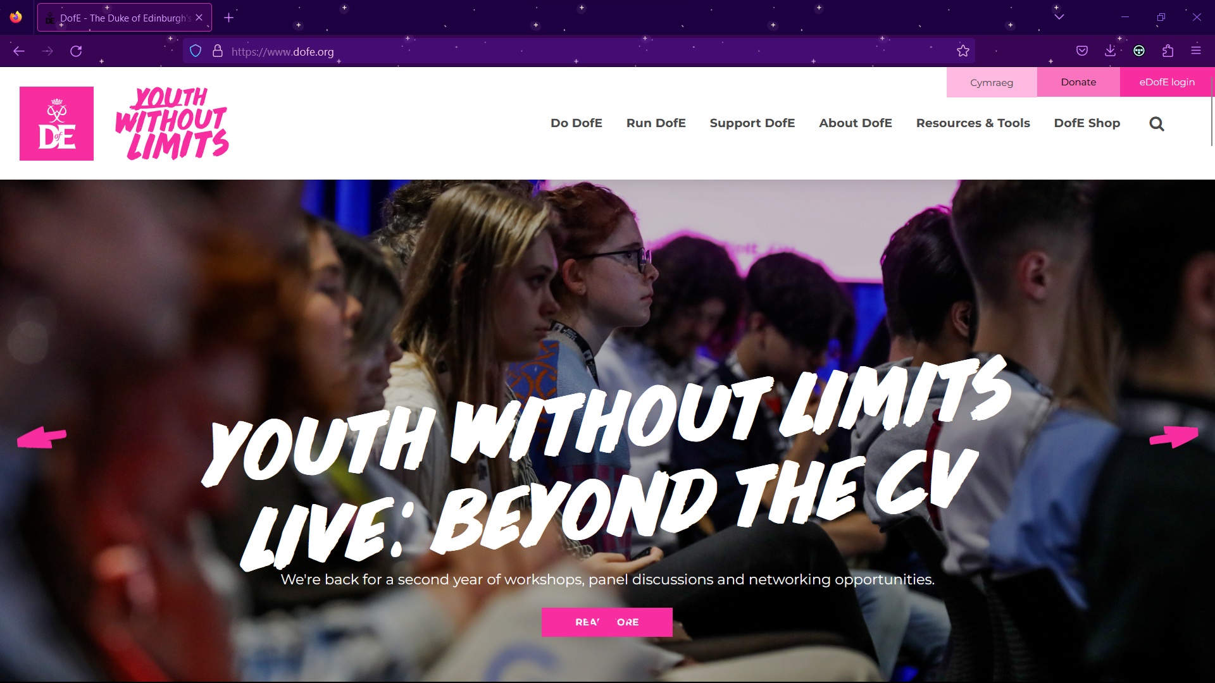
Gamifying Learning – Duke of Edinburgh and other ways

Slide 11
Gamifying Learning
Possible solutions:
Host regular tournaments in lessons
Awarding of points/grades earlier, change how we rank players
Reward ALL success

Slide 12
Flipping the Script
Cognitive Science (the art of teaching and learning)
Gamifying Learning
Technology and Teaching
What makes the ideal bridge lesson?

Slide 13
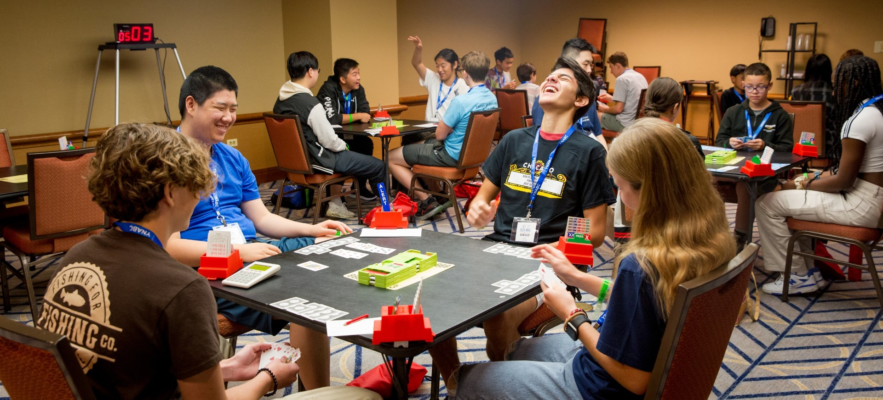
Making technology work for us

Slide 14
Flipping the Script
Cognitive Science (the art of teaching and learning)
Gamifying Learning
Technology and Teaching
What makes the ideal bridge lesson?

Slide 15
Flipping the Script
Cognitive Science (the art of teaching and learning)
Gamifying Learning
Technology and Teaching
What makes the ideal bridge lesson?
What does a bridge youth player look like?

Slide 16
The Ideal Bridge Youth Player
Regularly attends lessons
Make and keep bridge friends
Occasional tournament play
Bridge as a social skill
Actively seeking, part of something bigger
They are their own principled person

Slide 17
Flipping the Script
Cognitive Science (the art of teaching and learning)
Gamifying Learning
Technology and Teaching
What does a bridge youth player look like?
What makes the ideal bridge lesson?

Slide 18
The Ideal Lesson is what your students want
Regular lessons, building depth slowly and complexity when they are ready
Students making connections and partnerships
Show the competitive AND cooperative nature of bridge
Bridge as a social skill
Showing that they are part of a live and growing community
Teaching principals and etiquette as part of their bridge experience

Slide 19
Looking forward
Chess as a test-case:
https://www.polygon.com/tabletop-games/23679440/teens-love-chess-memes-boom-2023
2. Recommendations
3. Thank you

Slide 20
Flipping the Script
Rethinking How We Teach Bridge to Youth
mgrushworth@outlook.com

