Slide 1
Frameworks for Junior Coaching
Alan Shillitoe
England U16 Squad Leader
October 2023

Slide 2
About Me
Involved with England Junior Squads since 2003 – all age groups (U16, U21, U26) – currently U16
Around 200 players coached who have played internationally
Coached at all levels from beginner to World Championship final
Former England Junior international – learned at school
BSc Sport and Exercise Science
No formal teaching qualifications
Not paid in my role – volunteer!

Slide 3
Introduction
Dealing with wide range of ages and experience
Frameworks to inform/guide youth development
Understanding research from other areas
Changing roles as players develop
Skills and feedback – relationship to roles
Optimising training for skill development

Slide 4
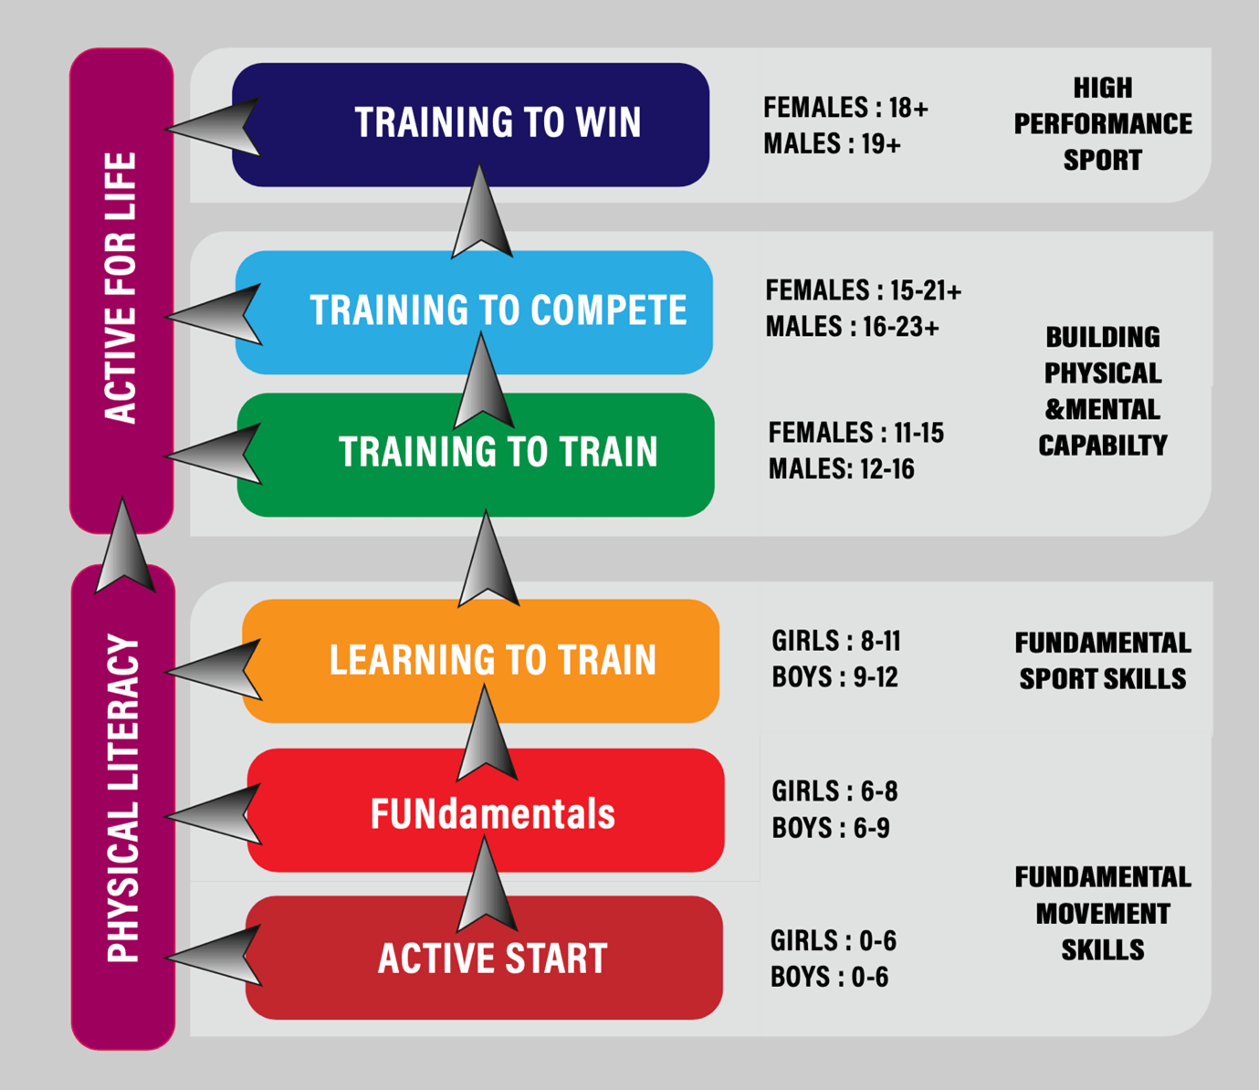
Example of Physical Development Model – Long Term Athlete Development
Some elements applicable to Bridge:
Concept of development phases
Some age linkages – not all
Physical development does not
map neatly onto mental development
From : https://www.isspf.com/long-term-athletic-development-in-youth-soccer/

Slide 5
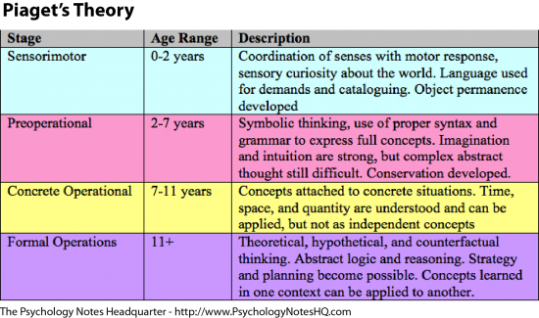
Piaget’s Stages of Cognitive Development
Cognitive phases of development map better onto early years of mindsport development.
Can we produce a basic hybrid model?
From: https://www.psychologynoteshq.com/piagetstheory/

Slide 6
Coaching Through the Years – A Framework for Bridge?
Age Group (Typical) | Type of Relationship | Primary Style
8-10 | Facilitator | Play for fun
10-12 | Teacher | Elementary skills
13-15 | Teacher/Coach | Foundational technique
16-20 | Coach | Advanced technique & partnership development
21-25 | Mentor/Coach | Expert (open standard) mindset
PLAY FOR LOVE!

Slide 7
Teacher, Coach or Mentor?
TEACHER | COACH | MENTOR
Addresses knowledge gaps | Builds on existing knowledge | Provides deeper insights
Directive/telling – provides answers | Asks open questions for reflection | Provides suggestions/advice
Performance against syllabus | Measures performance | Doesn’t measure performance
Most structured | Can be standardised for group or personalised for individual | Personalised 1-2-1 relationship
Develops knowledge base | Raises awareness | Shares lived experience
EVOLVING RELATIONSHIP

Slide 8
Skill Training and Acquisition
Open and closed skills
Open – skills performed in a dynamic and changing environment including influenced by opposition
Examples - Bridge judgement in bidding and play, especially live matchplay.
Lots of reliance on experience
Closed – skills performed in a familiar, stable and controlled environment
Examples - standard ‘book positions’, structured training
Useful for beginners to learn but need to adapt
These require different approaches to optimise training

Slide 9
Improving Skills Training
Open | Closed
Gamify - varied but contextual environments and situations | Deconstruct the skill into parts
Encourage self-exploration for solutions | Repetition to create ‘mental memory’
Practice under pressure | Introduce variations/pressure to promote skill transfer into dynamic game
Feedback: Situational | Feedback: Technical (and frequent)
Coach/Mentor oriented | Teacher/Coach oriented

Slide 10
Play, Play and… More Play! Positive Skill Retention
Drivers of positive skill retention:
Contextual play
Active involvement in driving learning process
Optimised challenge of learning experience
Self-involved learning
Skills testing – periodic but spread out
Delayed feedback – allow the student time first to self-reflect
Interleaving – teach multiple subjects simultaneously to prevent getting too focused on one
Training under pressure
THE KEY IS HOW WE APPLY THIS TO IMPROVE OUR TRAINING METHODS!

Slide 11
Skill Feedback Loops
PERFORM
PLAN
MEASURE
ANALYSE

Slide 12
Intrinsic and Extrinsic Feedback
 | Intrinsic – Student produced | Extrinsic – Coach/teacher produced
Advantages | Self correction of errors – powerful self-learning tool | Better for inexperienced players Usually more accurate/objective
Disadvantages | Inexperienced players lack knowledge of what ‘good’ is. Can’t analyse and correct. May be less accurate/objective | Student can become over-reliant – prevents development of self-learning Too much is overwhelming Requires appropriate standard coach – bad quality feedback can be damaging
FIND THE BALANCE!

Slide 13
Feedback – Good and Bad
Focus on process/goals – HOW (with a little bit of WHY)
Reinforce positive behaviours
Correct errors in process
Identify specific elements, not vague generalisms
Not on results!
Better results generally follow from good process
Don’t just give answers
Rationale/process
Answer questions with (sequences of) questions – break into steps, generate more analysis from the student

Slide 14
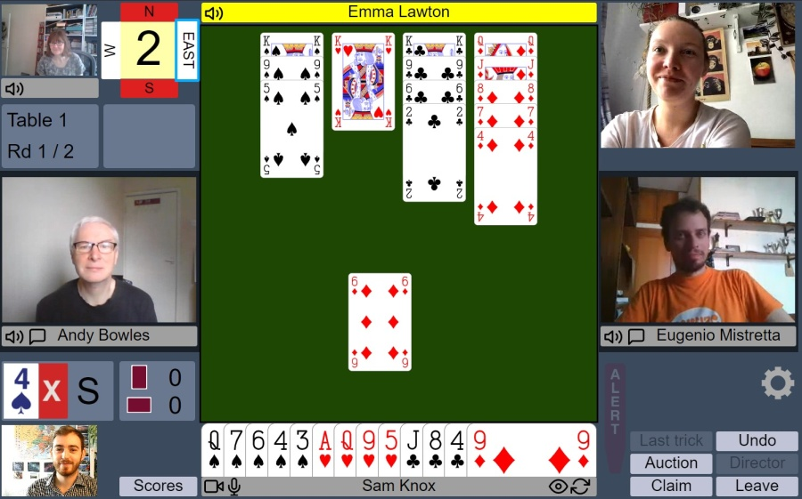
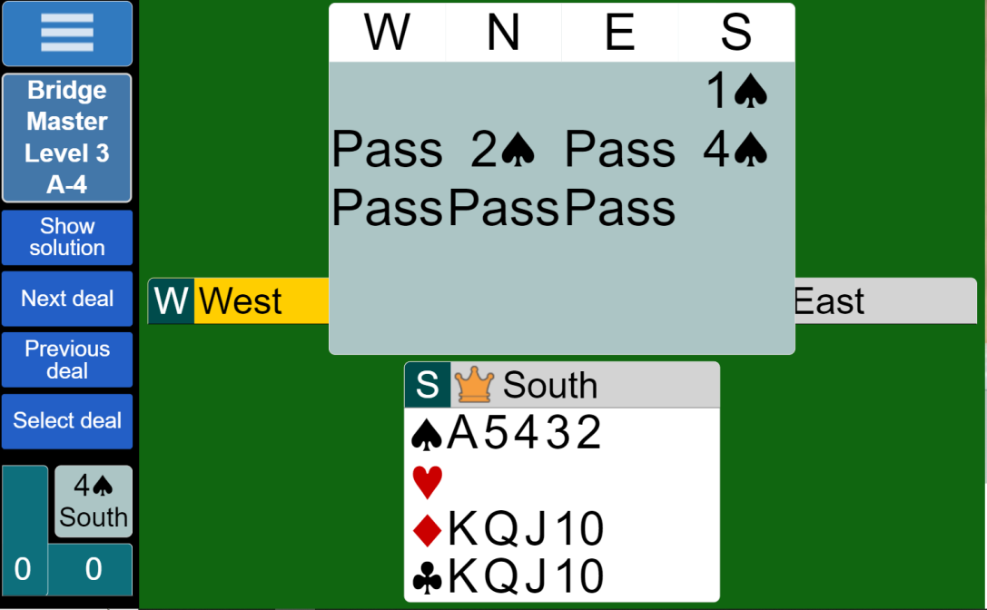
(My) Tools of the Trade
RealBridge, Cuebids, Bridgemaster
Gamification, context, feedback.
And...WhatsApp?

Slide 15
The Power of Community
Social driver for retaining critical mass of players within group
Wide base of players supports a higher top group
Drives peer-to-peer conversation –
Self-involved learning happens naturally. Far more powerful than coach/teacher-led instruction alone
Do not confuse social cohesion with task cohesion
Still need to establish shared task goals for championship group
Focus of training
SUPPORTS
INSPIRES
Focus of inclusion

Slide 16
Any Questions?
Thank you for your time!
All feedback and comment is appreciated
alan_shillitoe@hotmail.com

