Slide 1
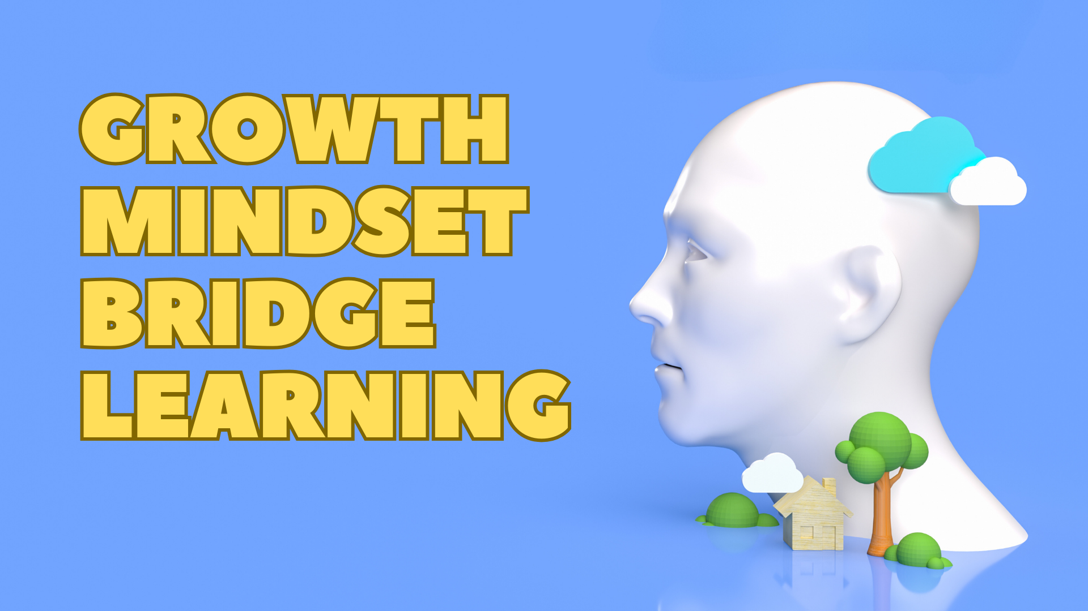
BRIDGE LEARNING with a GROWTH MINDSET
David Loeb
Copyright 2023

Slide 2
Agenda
Growth mindset:
Definition
Benefits
Cultivating a growth mindset for bridge learning
Recommendations for teachers
Summarized as time permits
More details available in supplementary material

Slide 3
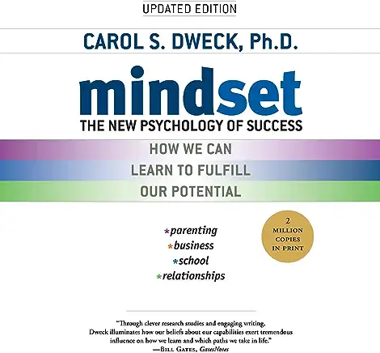
Mindsets
Growth mindset believes:
Skills and intelligence can be grown and developed
People who are good at something are good because they built that ability
They are in control of their abilities
Skills are built -- you can learn and grow
Fixed mindset believes:
Skills and intelligence are set
You either have them or you don’t
Some people are just naturally good and other are not
They are not in control of their abilities
You can’t learn and grow
Notes:
Individuals who believe intelligence is malleable (a growth mindset) are better able to bounce back from failures than those who believe intelligence is immutable. Event-related potential (ERP) studies among adults suggest this resilience is related to increased attention allocation to errors. W

Slide 4
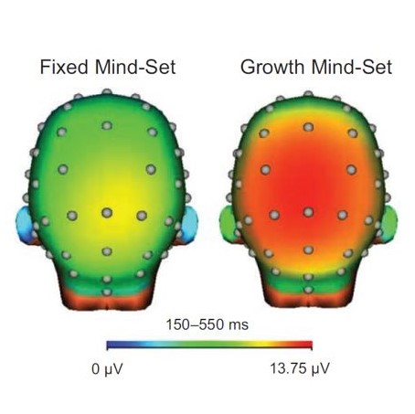
Mindsets Influence Learning
Using neuroimaging, researchers have found a link between a growth mindset and activation in two key areas of the brain:
The anterior cingulate cortex (ACC) Learning and impulse control
The dorsolateral prefrontal cortex (DLPFC) Error-monitoring and behavioral adaptation

Slide 5
Growth Mindset Promotes Learning
How well people bounce back from mistakes depends on their beliefs about learning
Growth mindset:
Mistakes are seen as opportunities to learn and improve
Neural activity showed a greater allocation of attention to mistakes
Demonstrated superior accuracy after mistakes
Fixed mindset:
Mistakes indicate lack of ability
Less attention to mistakes
Less accuracy after mistakes
“Mind Your Errors” Moser et. al. Psychol Sci. 2011 Dec;

Slide 6
Brain Imaging Explanation
How well people bounce back from mistakes depends on their beliefs about learning
Growth mindset:
attention focused externally to “regulate sensory and response selection”
more interested in finding out what the correct answer was
Fixed mindset:
more activity in a part of their limbic system that deals with regulating their internal emotional response.
view negative feedback as a threat to self-perceptions about ability
not as an opportunity to improve
“Why do beliefs about intelligence influence learning success?” Mangels, et. al., 2006

Slide 7
Growth Mindset Helps All Ages
New neurons are formed throughout life
“Human hippocampal neurogenesis persists throughout aging.” Fulmore et. al.
Neuroimaging studies show lifelong brain plasticity
Practice leads to
Improvement in and refinement of performance
Altered brain activity
Structural changes
“Aging and Brain Plasticity” Pauwels et. al.

Slide 8
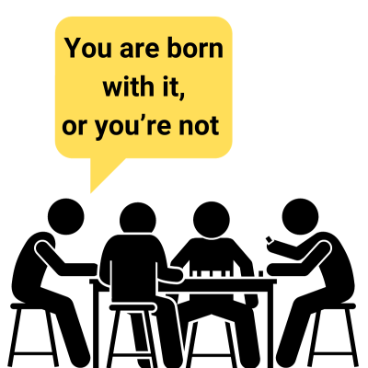
Teacher Mindset Impacts Learning
Fixed mindset teacher
Abilities are innate
Cannot grow and learn
Tells students efforts to improve are wasted
Students at the teacher’s club are making little progress

Slide 9
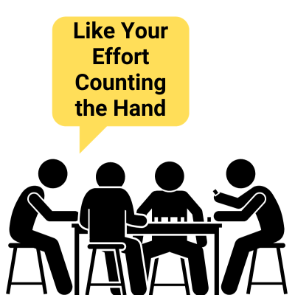
Teacher’s Growth Mindset Facilitates Learning
Growth mindset teacher
Skills are built
You can grow and learn
Students at the teacher’s club are growing their skills

Slide 10
Contrasting Reactions to Going Down
Growth mindset bridge student:
“What should I have done differently?”
“What clues were available to choose the winning line of play?”
“Should I have downgraded my hand and declined the invitation?”
Fixed mindset bridge student:
“I went down because I am a bad declarer”
“We got too high. I will never be a good bidder”

Slide 11
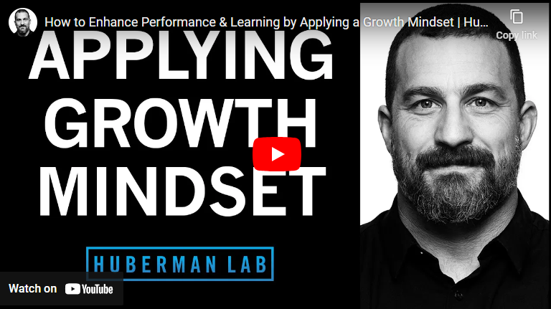
Helping Bridge Students Apply a Growth Mindset
Share your belief that
Abilities can improve with effort
Taking on challenges like bridge helps you form neural connections which increase your abilities
Share studies of the benefits of a growth mindset
Use the previous slides
Show the Huberman Labs video https://www.youtube.com/watch?v=aQDOU3hPci0
Recommend Carol Dweck’s “mindset” book

Slide 12
Reward the Process
Don’t praise the result
“Great play to make 3NT”
“Brilliant lead to beat 4♠”
Praise the process to reinforce effort and learning
“I like the way analyzed who was the dangerous opponent and worked to keep them off lead”
“You listened carefully to the auction and assessed how the points were distributed. I like how you used those inferences to determine a trump lead was needed to reduce ruffing power.”
See Carol Dweck’s “mindset” book for many examples of the benefits of praising the process

Slide 13
Challenge Yourself & Learn from Setbacks
Get feedback
What did you do well
Where can you improve
Discuss hands with experts
Organize discussions about hands played after your games
Challenge yourself
Leaving your comfort zone provides opportunities to learn
Encourage students to play in open games
The challenge will help them learn
Accept failure as part of the process
Setbacks and confusion are part of the learning process
See occasional ‘failures’ as learning opportunities

Slide 14
Growth Mindset Discussion of Boards Played
Before the game:
Invite players to join you after the game to learn from the boards they played
Suggest players circle boards where they have a question
Advise against teaching or criticizing at the table
We will discuss the boards after the game
After the game:
Invite players to brag about boards where the did well
Praise the process, not the result
Invite players to commiserate on boards which went poorly
Provide constructive advice focused on
Clues available to find the right action
Risks and rewards of options
Recognizing the problem and asking about it is progress

Slide 16
Structure Lessons for the Growth Mindset
Lessons focusing on why rather than what
Position students to use reason rather than memorization
Emphasize the fundamentals on which bidding and play is based
Scoring system
Benefits of a trump fit
Game priorities
Goals players have during the auction, etc.
Reinforce a growth mindset in post-mortem discussions following a game

Slide 17
Position Students to Reason Through Agreements
Teach a natural style of bidding which is popular in your area
ACOL is an example of a natural bidding system
2/1 Game Force uses natural bidding after a game forcing response
SAYC is not, often requires a minimum opener to conceal their shape
Teaching Conventions
Present the problem a convention solves
Present the convention as an intuitive & efficient way to solve the problem
Enable students to reason through the logic of the agreement rather than memorize it

Slide 18
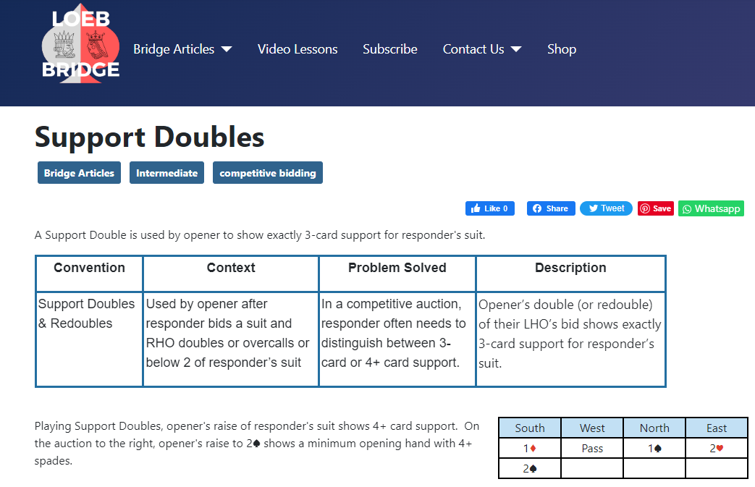
Example of Focusing on the Problem Solved

Slide 19
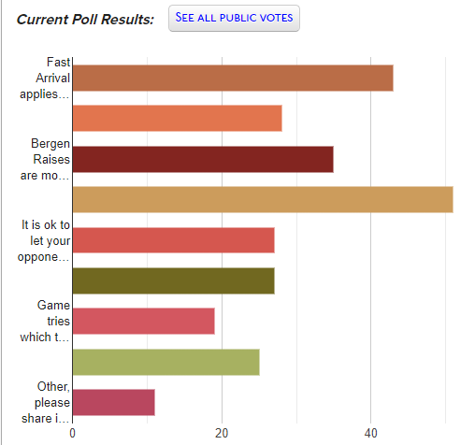
Teach Students Agreements They Can Keep
Teach students agreements they can use as they progress
Demotivating to throw away agreements you worked to learn
Some simplifications are needed
If a better approach can be easily taught, don’t teach a bad habit to simplify the game
Stolen bid doubles
Help suit game tries
Fast arrival opposite an unlimited hand
Need 6 points to respond
etc.

Slide 20
Summary
Growth mindsets promote learning and resiliency
Help students develop a growth mindset
Share evidence of the benefits of a growth mindset
Share your belief bridge skills can grown with work
Teaching bridge with a growth mindset
Praise effort, not results
Position students to use reasoning to choose their bid or line of play
Teach a natural style of bidding
Introduce conventions based on the problem they solve
Review hands after a game focusing on the process
Avoid teaching agreements which will be discarded

Slide 21
Visit LoebBridge.com for articles to help you improve and have more fun at the bridge table.
Our video lessons are available to subscribers at: LoebBridge.Locals.com
Please share your comments and questions.

